Slide 1
Crossover Operators for Hardware GP using FPGAs and Handel-C
Peter Martin and Riccardo Poli
University of Essex, UK

Slide 2
Introduction
GP in hardware - why?
Field Programmable Gate Arrays (FPGAs) and Handel-C
Crossover operator
Alternative operators
Conclusions

Slide 3
GP in hardware
Speed up the operation of GP
  Solve hard problems
  Real time data processing for fitness
  Experimental investigation
Embedded GP systems

Slide 4
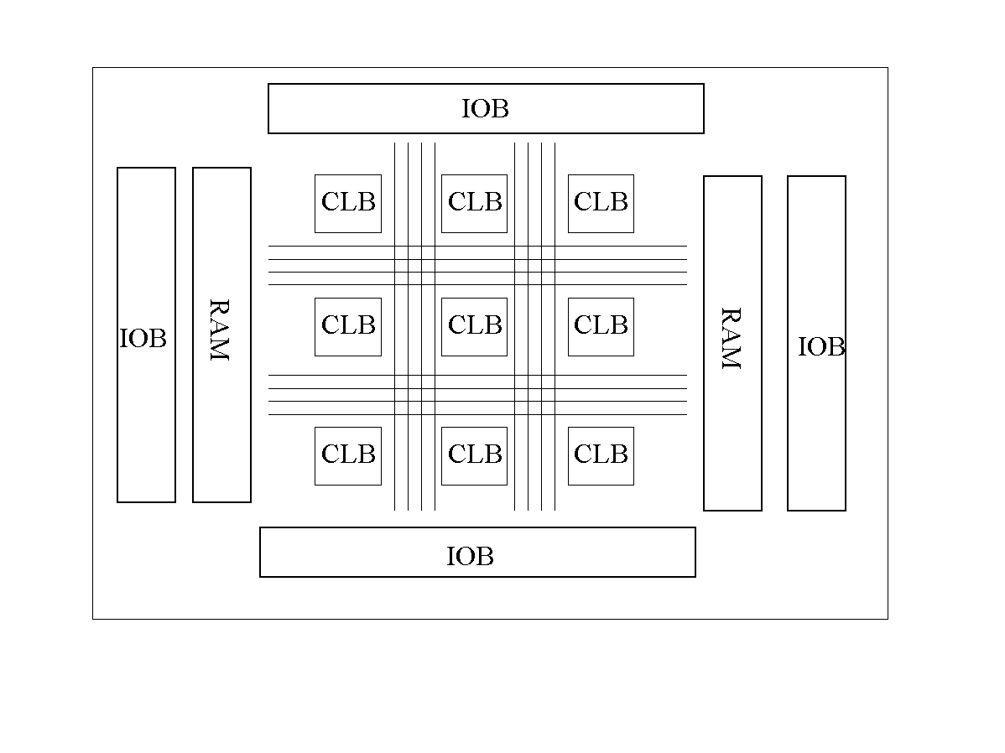
FPGAs
Re-configurable arrays of logic cells
Programmable logic functions
Flexible routing
On-chip memory

Slide 5
Handel-C
High level language to FPGA system
C-like syntax
Extensions for parallelism
    unsigned int 5 a,b;
    par {
    a = 10;
    b = 20;
    }
Predictable timing semantics

Slide 6
Design
Linear representation
Population in external RAM
Parallel fitness evaluations
  Replicated hardware

Slide 7
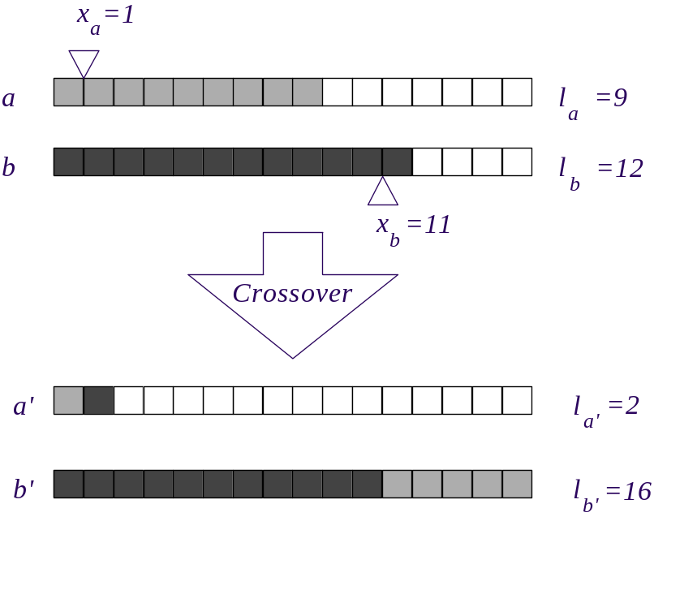
Truncating Crossover Operator
Fixed maximum length

Slide 8
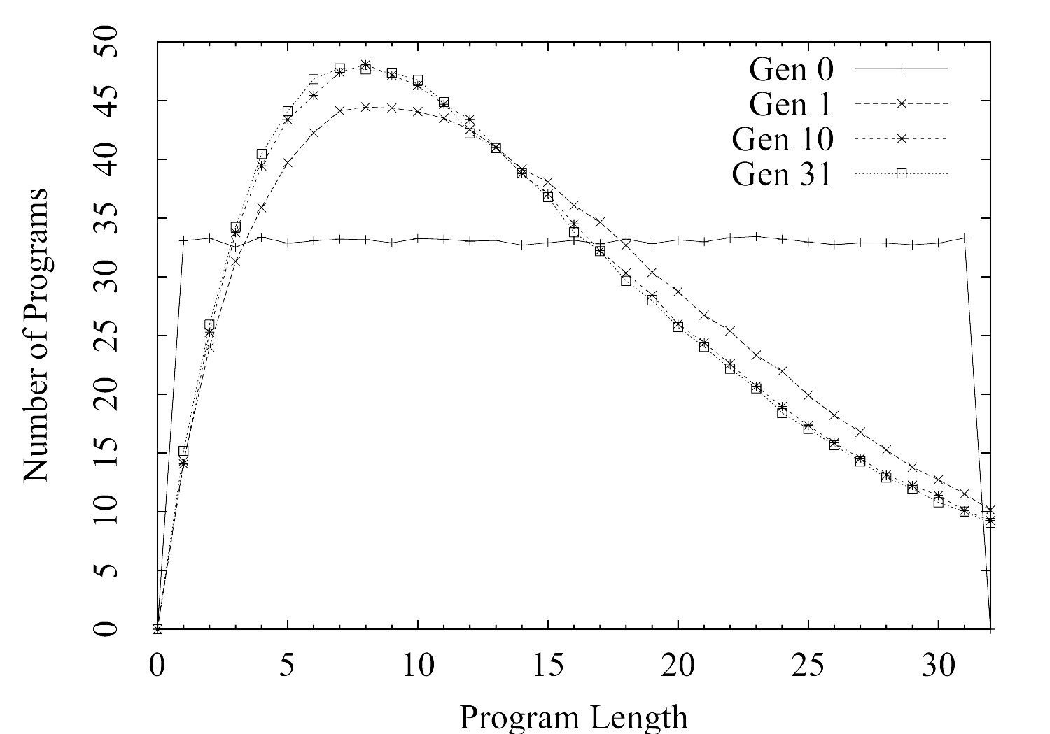
Length Distribution - Linear GP Without Fitness
Mean Length = 16 for all generations

Slide 9
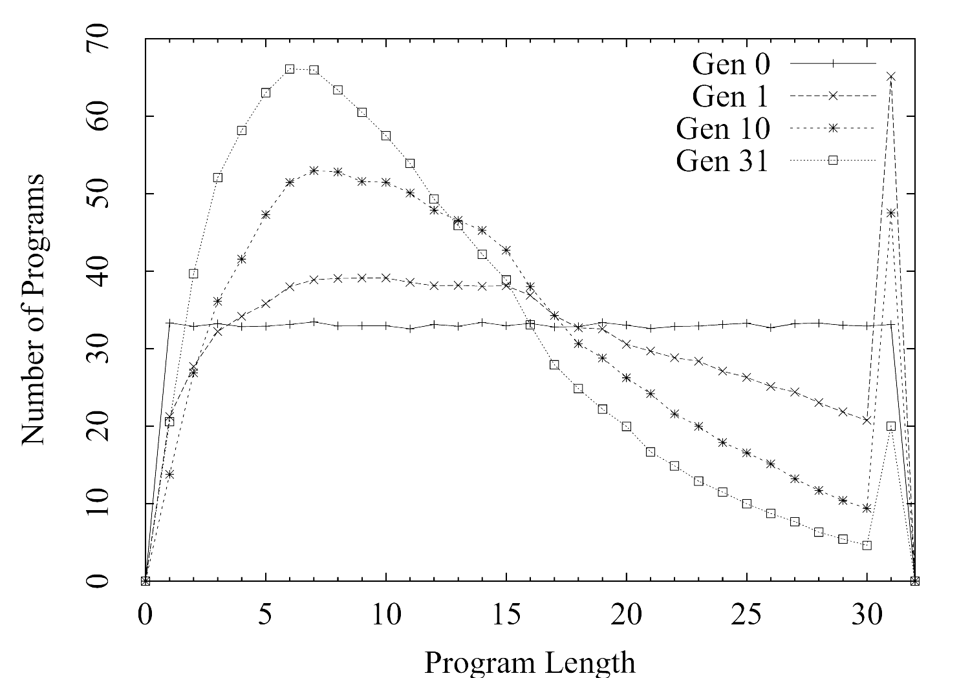
Truncating - no fitness
Mean Length = 12.5 at generation 31

Slide 10
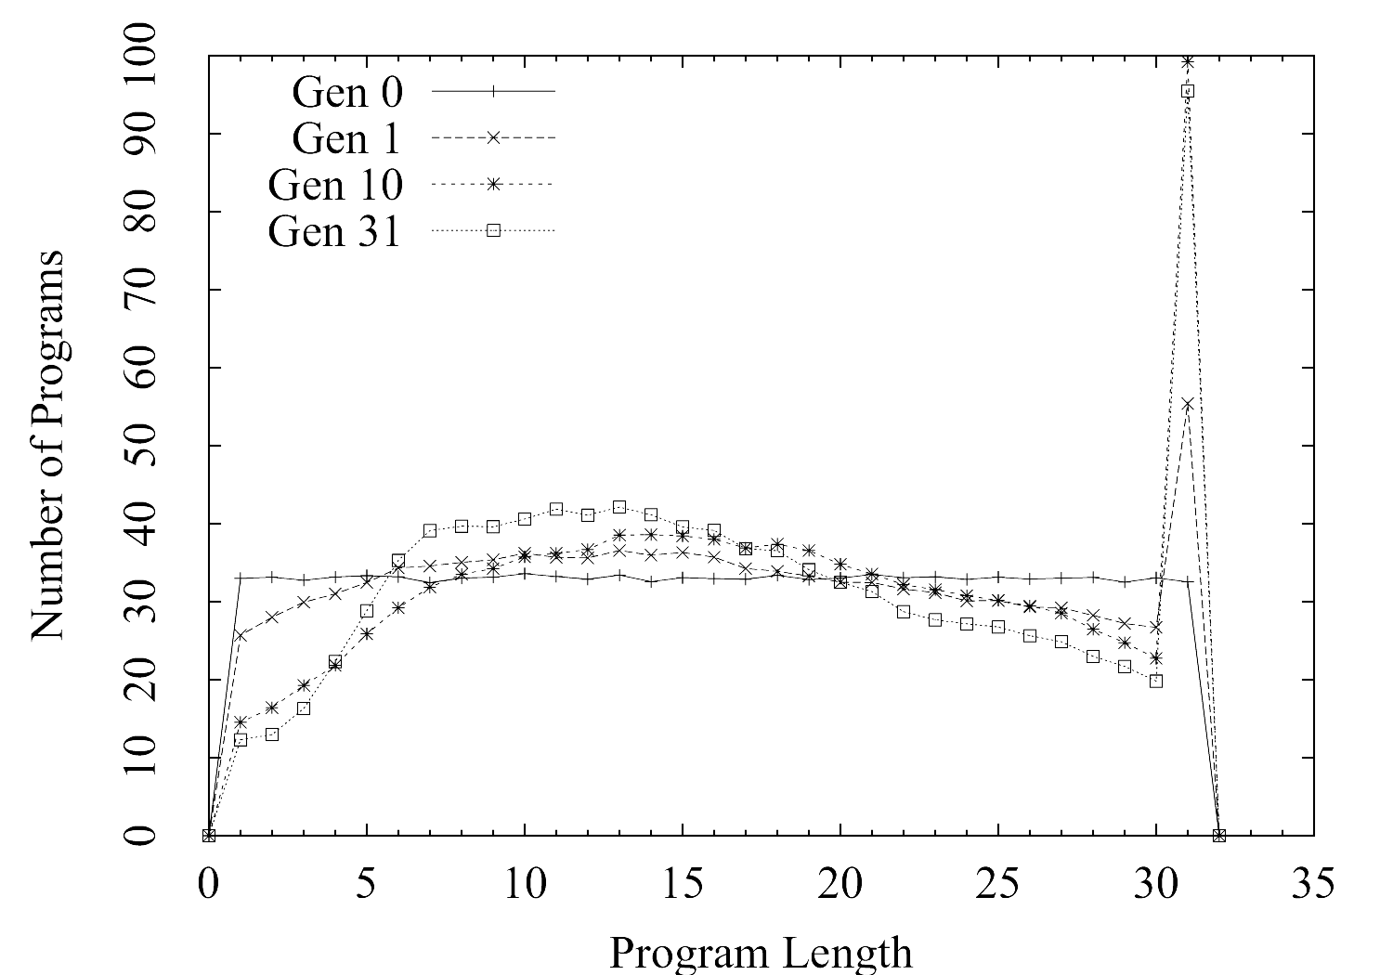
Truncating - with fitness (ant)
Mean Length = 17 at generation 31
68 correct programs from 500 runs

Slide 11
Limiting Crossover - I
Repeat selection of crossover points until BOTH offspring are smaller than L_{max}
Scheme used by lilgp
Dual Child Limiting Crossover

Slide 12
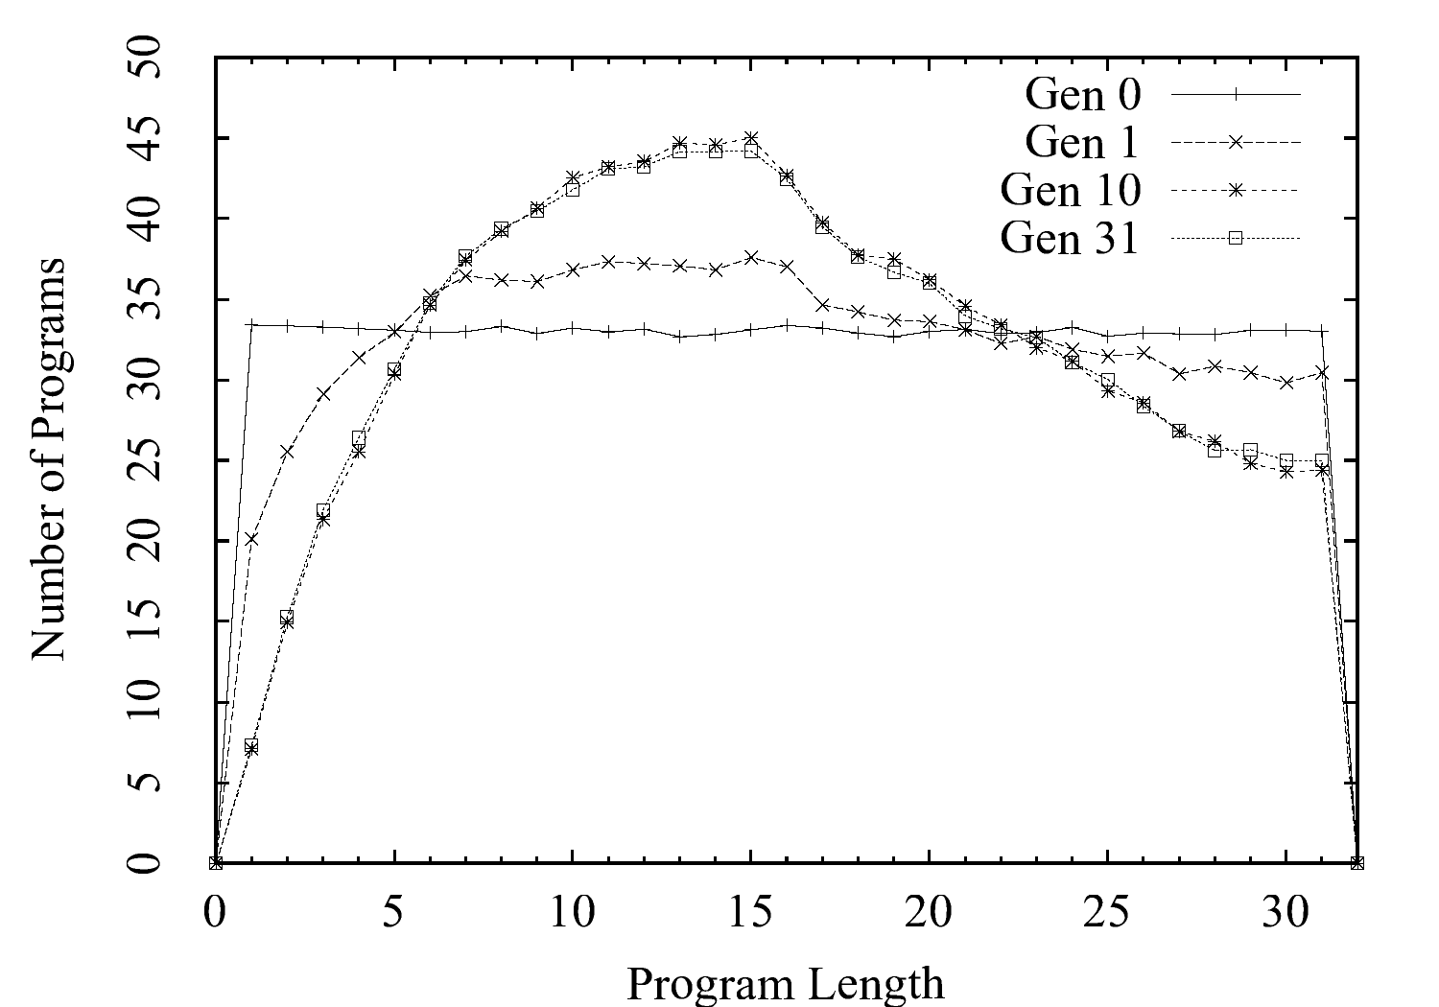
Limiting I - no fitness
Mean Length = 16 for all generations

Slide 13
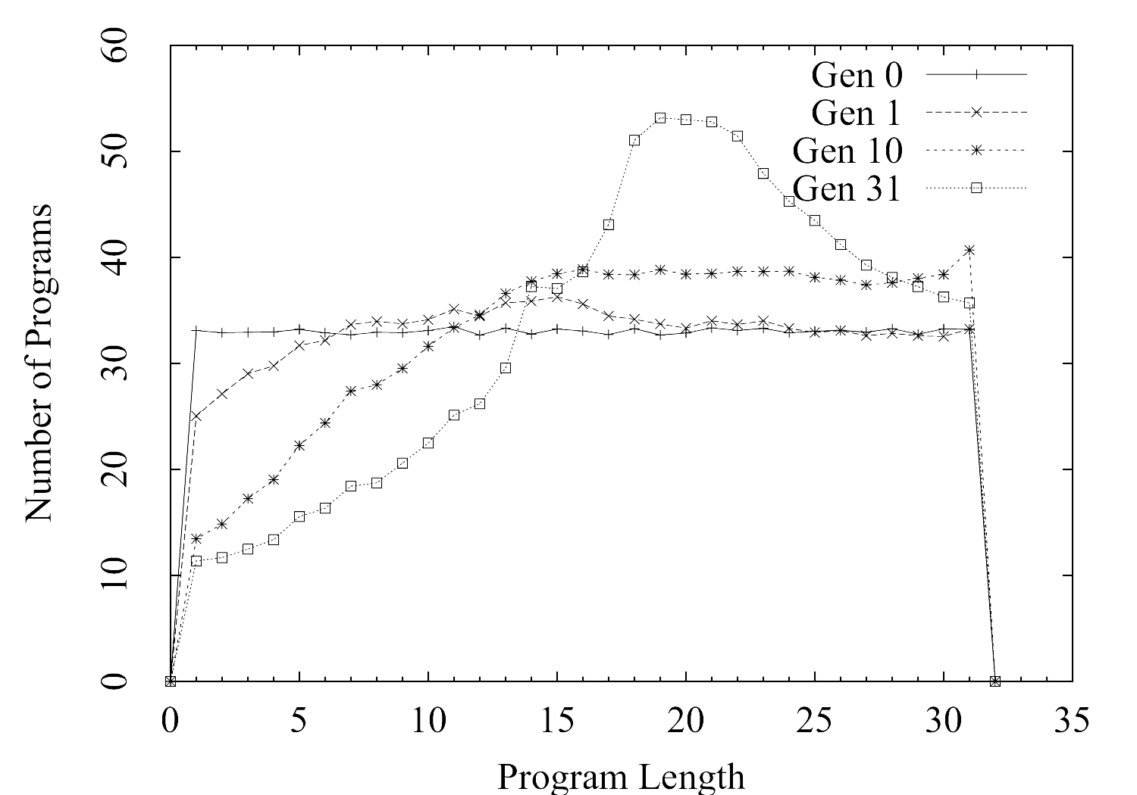
Limiting I - with fitness (ant)
Mean Length = 20 for generation 31
23 correct programs from 500 runs

Slide 14
Limiting Crossover - II
Repeat selection of crossover points until ONE or both offspring are smaller than L_{max}
Discard longer child if it is longer than L_{max}
Single Child Limiting Crossover

Slide 15
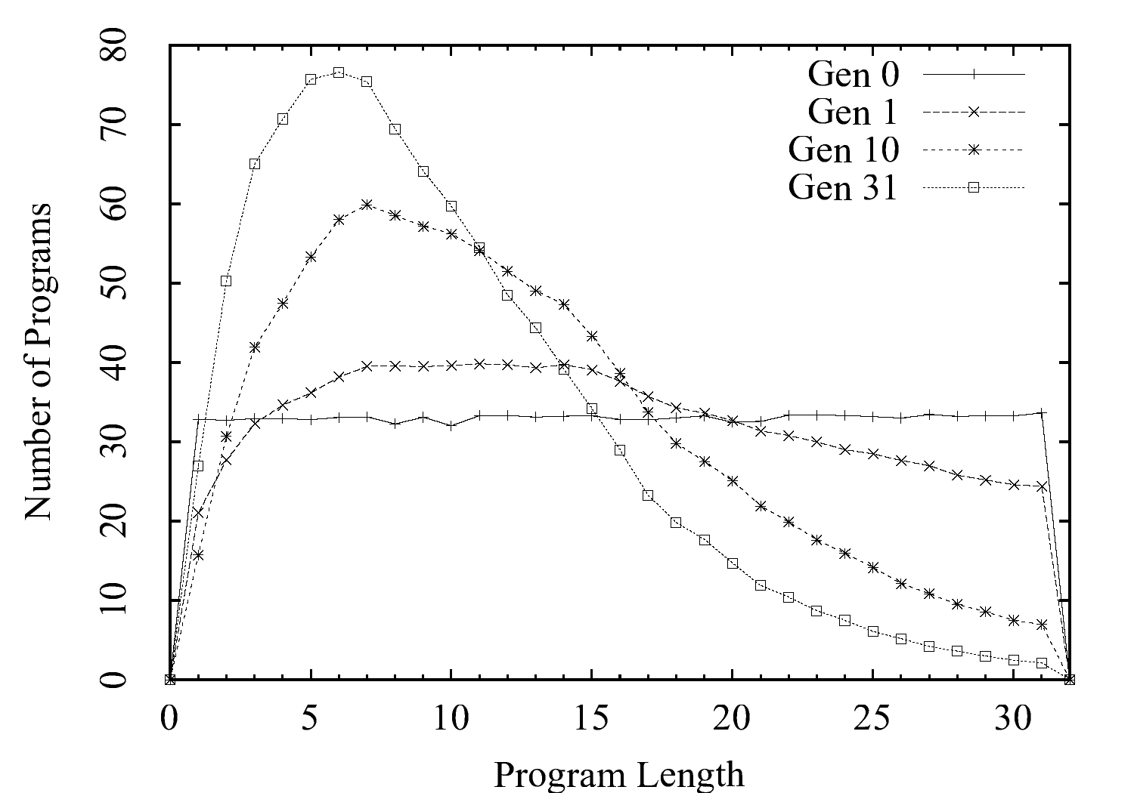
Limiting II - no fitness (ant)
Mean Length = 11 at generation 31

Slide 16
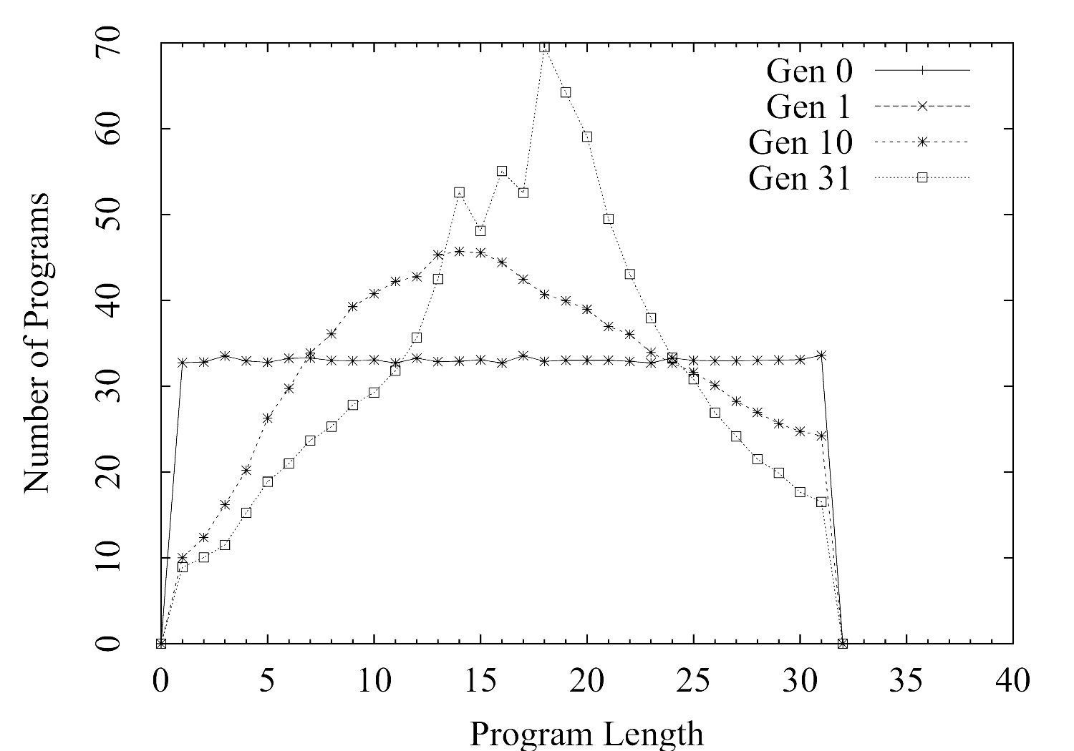
Limiting II - with fitness
Mean Length = 17 at generation 31
264 correct programs from 500 runs

Slide 17
Summary
Length distributions show biases
Single child limiting crossover
  appears to counteract bloat
  resulted in more correct programs
Future work
  Investigate single child crossover with tree based GP
  Test with other problems

